Slide 1
Customer Churn Analysis at Telco Company
M Zakie arfiansyah | 14/07/2025

Slide 2
Business Context:
Industry Context: Telecommunications industry (fictional) faces high competition with customer churn being a critical metric
Business Problem: Losing customers impacts revenue and increases acquisition costs
Problem Statement: “How to identify the factors influencing customer churn and develop effective retention strategies?”
Dataset Context:
Dataset IBM Cognos Analytics sample, with dataset contains of 7,043 customers/rows with 33 features/columns
Contains data of fictional telecommunications customers
Includes demographic information, services, and customer behavior
Target variable: Churn (Yes/No)
Primary Objective:
Analyzing the overall churn rate
Identifying key factors affecting customer churn
Understanding the profile of customers who tend to churn
Providing recommendations for retention strategies

Slide 3
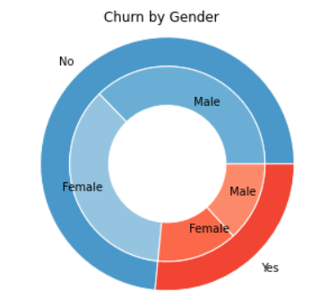
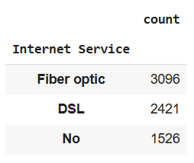
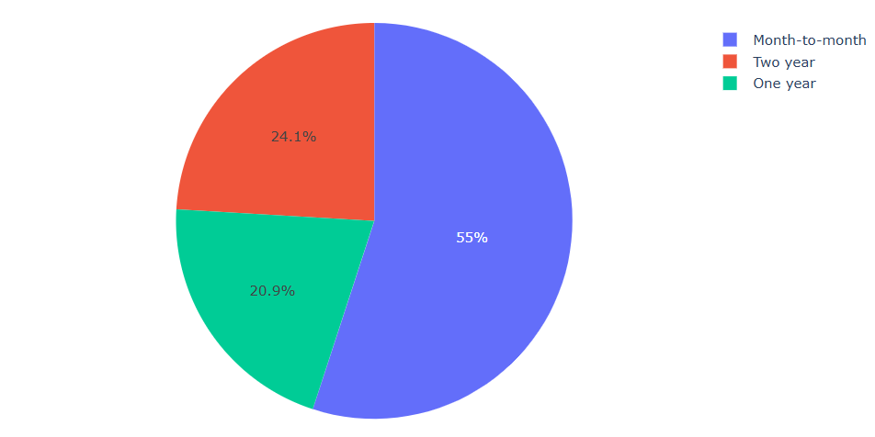
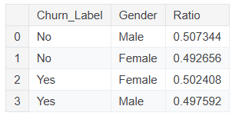
EDA (Overview)
7043
Total Customer
26,5%
Overall Customer Churn
33
Total Features
26,5%
Overall Customer Churn
Data Quality:
No missing values inside dataset
Balanced gender distribution (50.2% Male, 49.8% Female)
Total_Charges needs to convert from string to numeric
Categorical variables well-distributed

Slide 4
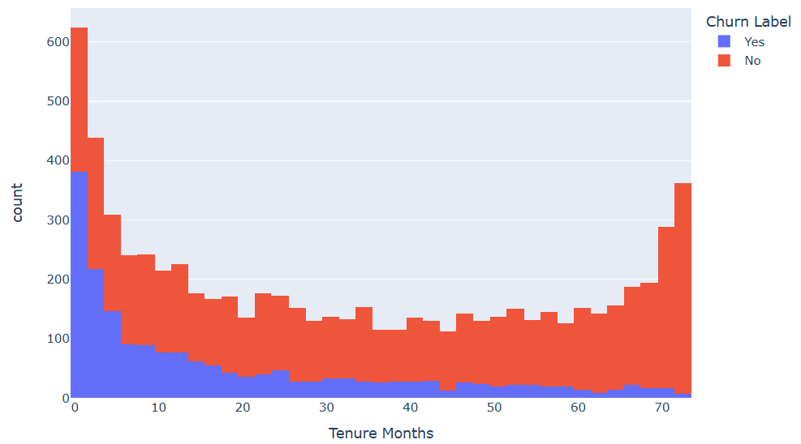
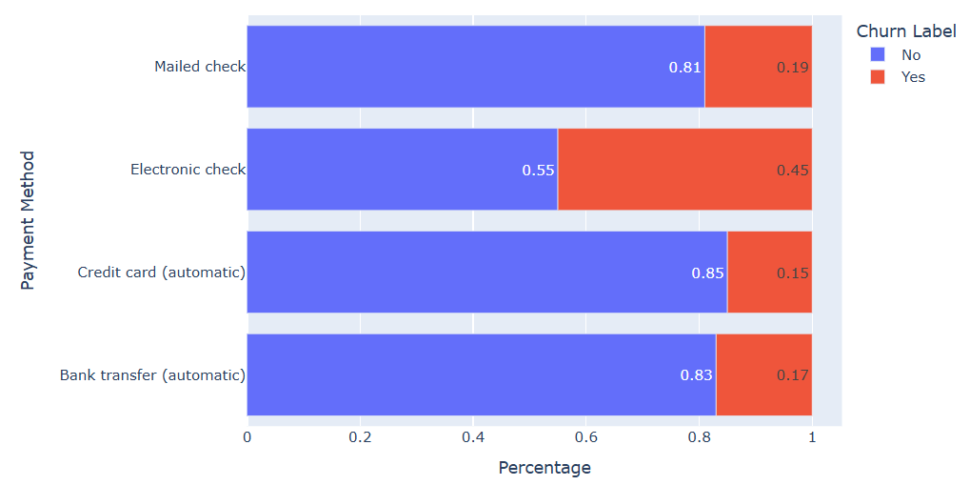
Tenure vs Churn Analysis
Payment Method Analysis
Key Findings:
The highest churn rate is in the first 0-12 months.
Customers with tenures greater than 24 months tend to be loyal.
Critical period: the first 6 months.
Churn Rate by Payment Method:
Electronic check: 45.3% (highest risk)
Mailed check: 19.1%
Bank transfer: 16.6%
Credit card: 15.2% (lowest risk)

Slide 5
Key Insights & Findings
High-Risk Customer Profile
Characteristics:
Month-to-month contract
Electronic check payment
Fiber optic internet service
Low tenure (0-12 months)
High monthly charges (>$70)
Senior citizen
No tech support
Loyal Customer Profile
Characteristics:
Long-term contract (1-2 years)
Credit card or bank transfer payment
DSL internet service
High tenure (>24 months)
Multiple services bundled
Tech support subscription
Online security enabled
Strategic Recommendations
Immediate Actions
Contract Optimization:
Promote long-term contracts dengan incentives
Offer contract conversion programs
Implement early termination penalties
2. Payment Method Strategy:
Encourage credit card/bank transfer payment
Provide discounts untuk auto-pay
Improve electronic check experience

